Slide 1
Experiment No:- 8
Aim: SINGLE SIDE BAND (SSB-SC) MODULATION SCHEME.
Software required: MATLAB
Theory:
MODULATION:- Modulation is a process , by which some characteristic of a carrier wave is varied in accordance with a modulating(message) signal.

Slide 2
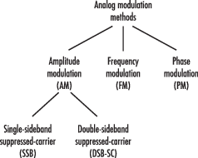
Analog modulation: It is a kind of modulation , where the message signal and the carrier wave both are analog in nature.

Slide 3
Single side band (SSB-SC) modulation:
Ssb-sc Is A Type Of Amplitude Modulation.
In conventional A.M we have two side band and the one carrier wave(no information is contained by the carrier) .
In SSB-SC modulation ,only one side band is transmitted because both USB(upper side band) and LSB(lower side band) having the same information.
Therefore the transmission bandwidth is reduced to half and also required less power compare to other method of A.M.

Slide 4
There are two method of generation of SSB-SC:
Frequency discrimination method.
Hilbert transform method or Phase discrimination method.

Slide 5
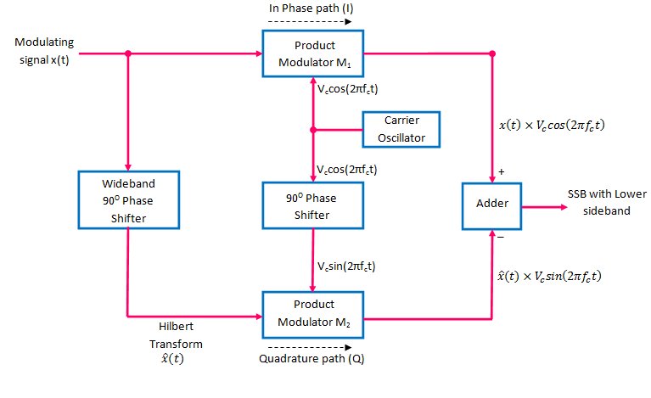
GENERATION OF SSB-SC: (By Hilbert transform method )

Slide 6
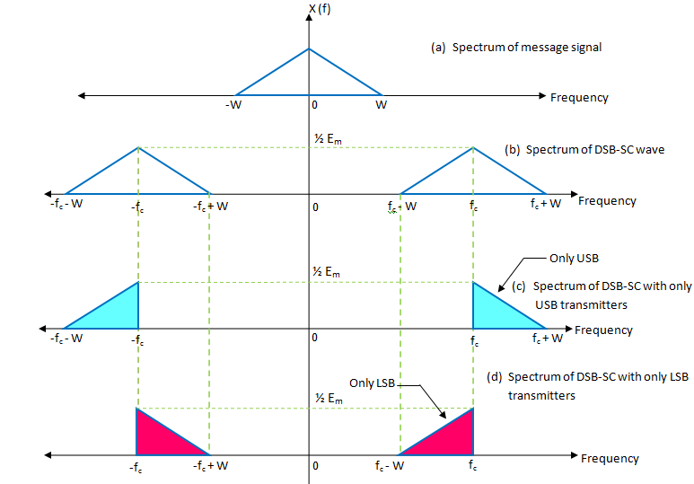
Expected result:

Slide 8
Applications:
In point-to-point communication.
Radar communication.
where the power saving and low bandwidth requirements are important .
In many voice application.

